Slide 1

SAP Analytics cloud training
Anubhav Oberoy
Day 9

Slide 2
Agenda – Day 9
Data Actions & Connections Basics
Data Actions in SAC
Introduction to Connections
Cloud Connector
Connecting to Import data with BW
Connecting to S/4HANA System
---Break---
Build CDS Views
Introduction to CDS View
Consume S/4HANA CDS views
Import data connection
Live Data connection with analytic Query

Slide 3

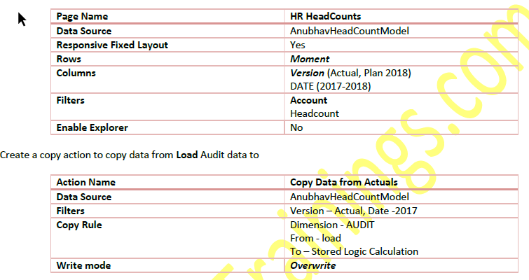
Requirement 1: Copy Data Action
Create Story action to copy the data of 2017 headcount to 2018 plan version
www.anubhavtrainings.com

Slide 4


Slide 5
Requirement 2: Auto calculate headcounts based on Scripting based actions
Finally, we would like to calculate the headcounts based on Hires and Terminations. For calculation, we have to set the opening balance to the ending balance of previous period and Add new hires and subtract the terminations to calculate the final balance. These set of actions needs to be repeated for entire duration on MoM basis.
This is performed using the scripting-based actions, for the ease of writing Anubhav will also show Visual way of writing the script.
CONFIG.TIME_HIERARCHY = CALENDARYEAR
CONFIG.FLIPPING_SIGN_ACCORDING_ACCTYPE = OFF
CONFIG.GENERATE_UNBOOKED_DATA = OFF
MEMBERSET [d/Date] = (BASEMEMBER([d/Date].[h/YQM], "2018"))
FOREACH [d/Date]
DATA([d/MOMENT] = "OPENING") = RESULTLOOKUP([d/MOMENT] = "CLOSING", [d/Date] =
Previous(1))
DATA([d/MOMENT] = "CLOSING") = RESULTLOOKUP([d/MOMENT] = "OPENING") +
RESULTLOOKUP([d/MOMENT] = "HIRES") - RESULTLOOKUP([d/MOMENT] = "TERMINATIONS")
ENDFOR
www.anubhavtrainings.com

Slide 6
What are all the challenges for CEO of a co?
Insight with a simple click
Taking decisions
Planning for future
Real-time information
Resource management
Different perspective at same time
Transparency
Fin
S/4HANA
Procure
Ariba
HR
SuccessFactors
Sales
Hybris Sales Cloud
Marketing
Sales Force
Travel
Concur
www.anubhavtrainings.com

Slide 7
Collaboration
Calendar
Comments
Share
www.anubhavtrainings.com

Slide 8
End of Day 7

Slide 9
Real SAC system Access
Acquired Data Connection
Connect to real time system only once, and pull all the data into SAC.
Data is stored inside SAC securely, Data security is subjected to SAC
Data needs to updated timely manner, you can schedule auto-updates.
All features can be accessed if its acquired data
e.g. Google drive, S/4HANA Acquired – CDS View
Live Data Connection
Data is never replicated to SAC, it lives in the original system (source system)
Only the skeleton (structure) of the data is represented in SAC Model
All the data transformation and Security is managed by Source System
Data is Real-time and storage cost in SAC is minimal
You can use existing assets like BI Universe, BW Bex Queries, Info providers, CDS views
Performance can go bad at sometime but we can tune
We can perform Close-loop scenario
www.anubhavtrainings.com

Slide 10
Connections
SAP analytic Agent
Public Cloud
Internet
Intranet
Source Systems
BW,BI,S/4H,ABAP,BO,HANA
On premise
SAC
SAP Analytics Cloud System
SAP Cloud Connector
InA
BTP
VPN
PC
S/4HANA, SF
HANA Cloud etc.
Azure, GCP, AWS
InA
Adaptor
www.anubhavtrainings.com

Slide 11
smartpredict-demo.us10.sapanalytics.cloud
SAP SAC Server
Browser
Connection to BW or S/4HANA
CORS Headers to browser
Exception to allow CORS call to me from browser
CORS
Cross Origin Resource Sharing
stcfin.st.com:8021/
S/4HANA
BW
ina
Hey! I am fine if someone make a CORS call to me!

Slide 12
SAP CP

Slide 13
Live data connection
B. Create an Adaptor (BAS)
Template program
Import the adaptor
Settings
Deploy it as webapp
SAC
HANA
Adaptor
C. Create a Live Connection(SAC)
To the adaptor
Build story
A . WebIDE
Develop HANA Tables
Load dummy Data
Create a model – CUBE – Calculation

Slide 14
CORS
https://sactrial-saceu10-f4aajqsq4u7m952hny9vpm8p.eu10.hanacloudservices.cloud.sap/
SAP Analytics Cloud
SCP
Browser
CORS
CORS Headers
SAC system
BW, BI, BO, ECC….
SAP S/4HANA
On Premise
Special permission
ina
http://sts4dev.st.com:8001/sap/bw/ina/getresponse?sap-client=800
www.anubhavtrainings.com

Slide 15
NW versions required to release CORS Headers
Check the system version of your ABAP based system
NW 7.52 SP02
NW 7.51 SP06
NW 7.50 SP13
NW 7.40 SP20
SAP Kernel Version 7.49PL315
2. Check if INA Service is active in the system. TCOODE: SICF and search for INA service
3. The system must be SSH enabled, HTTPS signed certificate (Network admin)- STRUST
4. Inform Our SAP system that we can offer CORS headers RZ10(system wide-need NW restart)
RZ9 (temporary)
Icf/cors_enabled
5. For On-premise systems running in Intranet, you need sap cloud connector
6. Add the settings to issue CORS headers to browser for your SAC system - UCONCOCKPIT
https://help.sap.com/viewer/00f68c2e08b941f081002fd3691d86a7/release/en-US/0d1cd72013804eb78e2aea45a562e439.html?q=uconcockpit
https://blogs.sap.com/2019/03/24/use-cors-for-your-netweaver-backend-connection-to-cloud-analytics/
www.anubhavtrainings.com

Slide 16
SAC
HANA
Calculation View
(data model)
ABAP on HANA training 9th April 2022
Weekend 7-9 IST
SAC
S/4HANA (ERP)
CDS View
(data model)

Slide 17
CDS – Core Data & Services
CDS stands for Core Data & Services, these are the data models in ABAP system which is based out of HANA DB. We have 2 types of CDS
ABAP CDS – ABAP system which runs on HANA
HANA CDS – Do not have ABAP system at all, we have just HANA
These are used to expose data out of system in form of Views.
ABAP on HANA – ADT
Native HANA – HANA WebIDE
With SAP S/4HANA system, There is NO BW system required anymore. SAP delivers 1000s of cds views for ready to use consumption.
www.anubhavtrainings.com

Slide 18
<Title>
Fiori App
BI Tools
Portal
SAC
Consumption Views
Consumption Views
Data Models
Interface Views
Interface Views
Interface Views
Private Views
Private Views
Private Views
Private Views
DB Tables
DB Tables
DB Tables
DB Tables
www.anubhavtrainings.com

Slide 19
Acquire Data Connection
Create a CDS View
Activate
Activate Odata service
Create an Acquire data connection
Pull all data from system and show in a dashboard
Sales

Slide 20
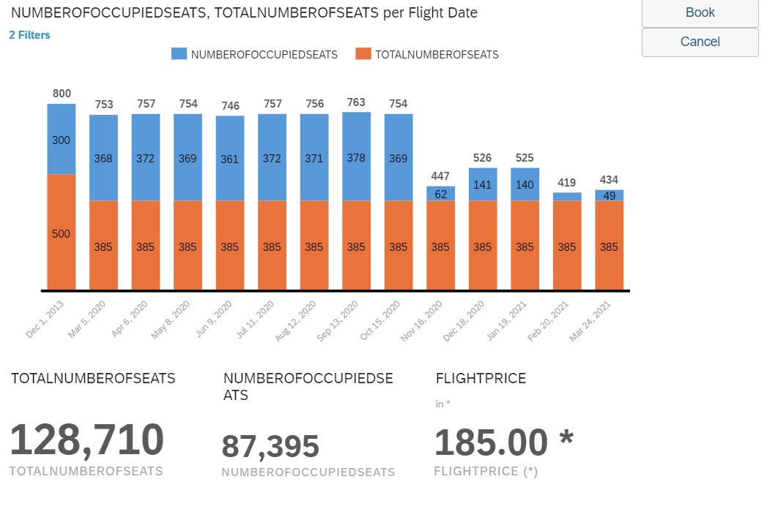
<Title>
www.anubhavtrainings.com

Slide 21
Feedback Link
https://feedbackind.vinsys.com/Indiafeedback.html?batch_id%3D483

Slide 22
End of Day 9

Slide 24

Questions

Slide 25

Anubhav Oberoy
anubhav.abap@gmail.com

